Slide 1

A&W CSAT Survey Mechanism Approach

Slide 2
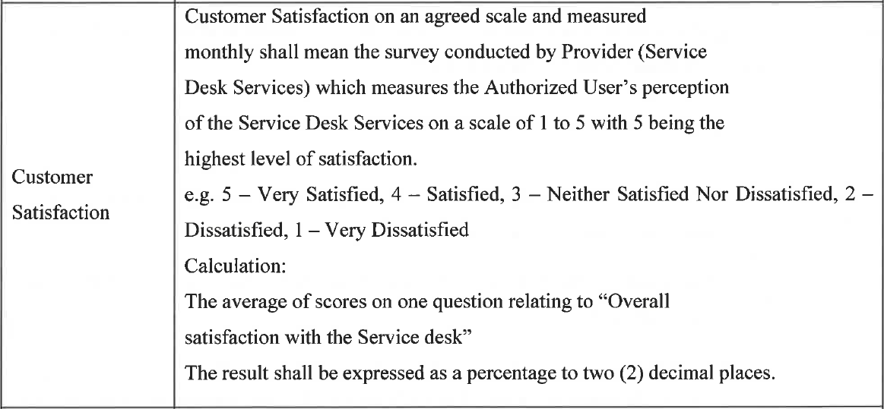
CSAT Calculation in SOW
Presentation Title | Author | Date
2

Slide 3
Sample Survey Email – On Resolved Incidents
Greetings from A&W Universal Support Desk!!
Recently, we assisted you with the following IT-related issue: INXXXXXX
As part of our ongoing effort to evaluate our quality of support, we'd like to request your feedback regarding the resolution of your issue.
Your issue details were:
Incident Number : INXXXXXX
Reported By : Name of the person who reported the Issue
Resolved by : Resolver Name
Short description : Short description of the issue
Click here for more details about the resolved incident : https://resolvedincidentURL
We would greatly appreciate if you could take few minutes to fill this quick customer satisfaction survey form by clicking below link: https://surveyformURL
“We invite, share and act on feedback to continuously learn and improve. ”
A&W Universal Support Desk Team
Presentation Title | Author | Date
3

Slide 4
Sample Survey Questions – English & French
Question | English
Q1 | Mode of contact ?
Options | Telephone
 | Email
 | Chat
Q2 | Speed of Resolution ?
Options | Fast
 | Average
 | Slow
Q3 | Overall communication Skills ?
Options | Excellent
 | Good
 | Poor
Q4 | Technical Knowledge of the Agent ?
Options | Excellent
 | Good
 | Poor
Q5 | Overall Satisfaction with the A&W Universal Support Desk ?
Options | Very Happy
 | Happy
 | Dissatisfied
 | Need a Call back
Q6 | Share your valuable Feedback Please…
Comment Section :
Note : We might have to slightly tweak the SOW definition of CSAT SLA measurement with the proposed changes.
Current Overall rating : 1 to 5 ( 5 being Very Satisfied as mention in slide-1 ). Change : 1 to 4 (1 being Very Happy)
Presentation Title | Author | Date
4

Slide 5
Proposed Definition and CSAT Calculation change
Customer Satisfaction
Custom Satisfaction on an agreed scale and measured monthly shall mean the survey conducted by Provider ( Service Desk Services ) which measures the Authorized User’s perception of the Service Desk Services on a scale of 1 to 4 with 1 being the highest level of satisfaction.
Eg. 1 – Very Happy , 2 – Happy , 3 – Dissatisfied, 4- Need a call back
Calculation :Average of scores on one question relating to “Overall Satisfaction with the A&W Universal Support Desk ”
Results shall be expressed as a percentage to two ( 2) decimal places.
Presentation Title | Author | Date
5

